Slide 1
Aspect Based Sentiment Analysis for Online Restaurant Review in Chinese
Group Name: 2023-Keith-4
Group members: Wong Ping Kuen (13031493)
Yeung Ho Yin Tommy (13024570)
Li Chi Fung (13031837)
Jon Rai (12749417)
Supervisor: Dr. Keith Lee
Notes:
Good afternnon everyone! Today im gonna present about our fpy topic
which is Aspect Category Sentiment Analysis for Online Restaurant Review in Chinese.

Slide 2
Introduction
The restaurant review website become more popular, some of the Restaurant review websites E.g. OpenRice, KeeTa
Provide review and rating
The users can share their experience in several aspects:
E.g. the food quality, service, price etc.
These website provided rating functionality, the customer can rate in each aspect.
Aspect-Based Sentiment Analysis (ABSA) is popular research in Natural Language Processing (NLP) that common need used to analyze the sentiment from the text.
Predict the reviews sentiment to positive, negative, and neutral

Slide 3
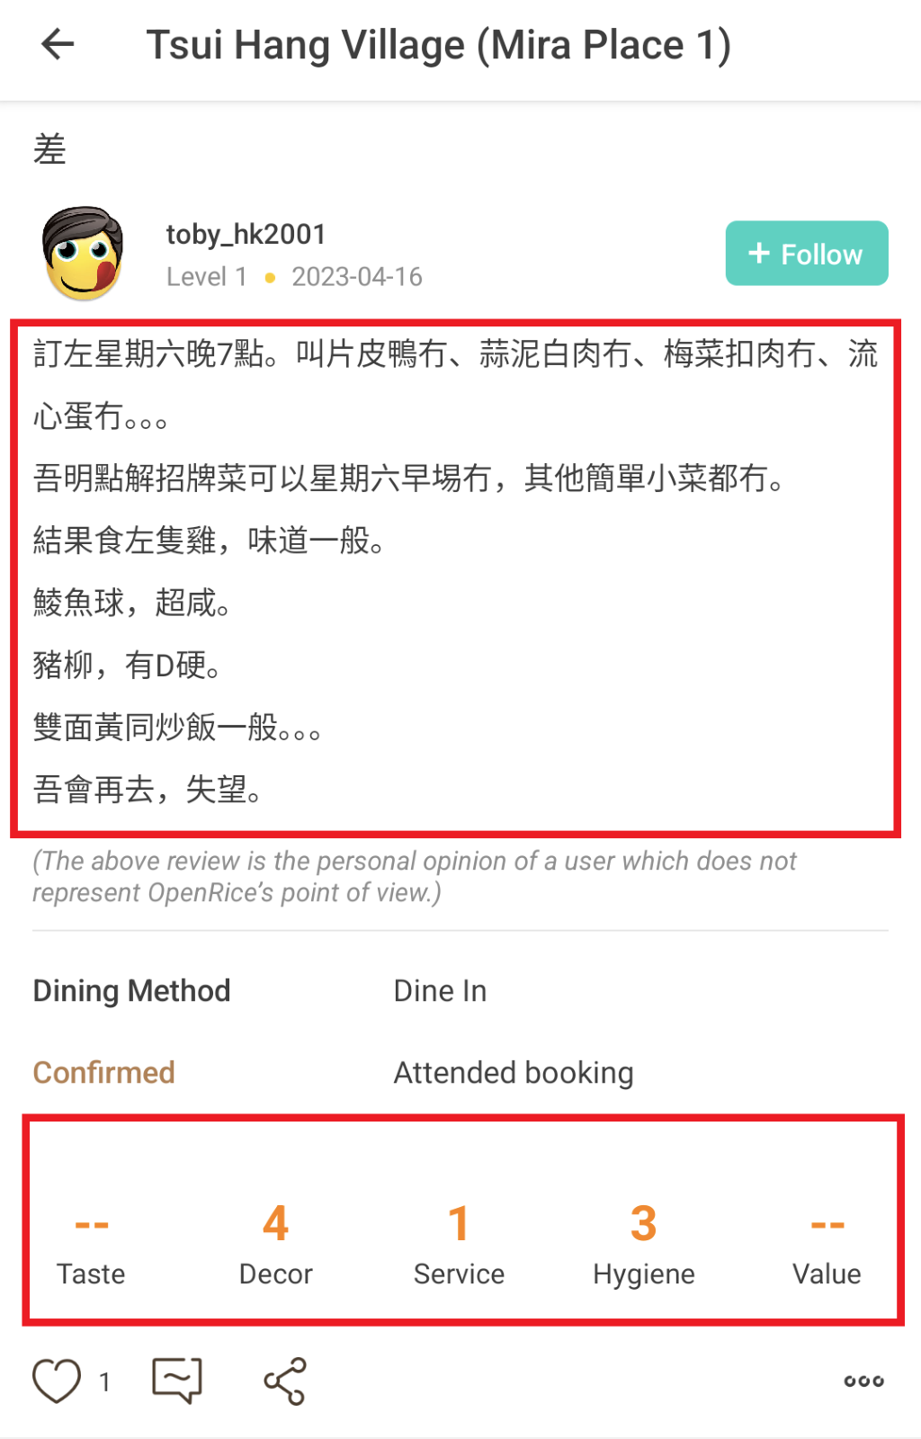
Problem Analysis
Reading the meaningful restaurant's comments always time-consuming.
Some rating are inaccurate:
E.g., A customer commented the food quality (taste) was bad, but didn't provide a rating score for Taste, he/she she only provides the score of Decor, Service, Hygiene.
ABSA research in Cantonese is Lack of resources because the researchers mainly focus on the English and Simplified Chinese.
A review screenshot from OpenRice

Slide 4
Project Aims
Develop a tool Restaurant Review Analyzer for Chinese Language
Analyze the Chinese review for Hong Kong restaurant
Assign scores for each aspect
Two type of users:
Restaurant owners
Restaurant's Customers

Slide 5
Project Objectives
To collect Cantonese review data (raw data) from HK restaurant review websites (E.g., OpenRice) for the preparation of building Chinese datasets.
To cleanse the collected data from the restaurant review website and label the cleansed data in each aspect to building the dataset.
To adapt the existing models of Aspect-Based Sentiment Analysis (ABSA) for Simplified Chinese to handle the Chinese (Cantonese) dataset.
To train the existing ABSA models with Cantonese datasets, and to evaluate the model's performance
To develop a web application for deploying the trained model to handle the restaurant review analysis task and show the analysis results.

Slide 6
Literature - Compared with ACSA and ABSA
Aspect-Category Sentiment Analysis (ACSA) | Aspect-Based Sentiment Analysis (ABSA)
Predict the aspects in coarse-grained E.g. food, service, environment | Predict the aspects in fine-grained E.g. Food portion, food tastes, environment cleanse, environment space
Both predict the sentiment polarity from text

Slide 7
Literature -Compare with existing ACSA and ABSA models
 | Aspect-aware graph convolutional network (AAGCN) | Syntactic and Semantic Enhanced Graph Convolutional Network (SSEGCN) | Fine-grained Sentiment Analysis of User Reviews from AI Challenger
ACSA / ABSA | ACSA | ABSA | ABSA
Neural Network Language Model | GloVe and Bert | BiLSTM and Bert | Word2Vec and Transformer
Neural Network | Graph Convolutional Network | Graph Convolutional Network | Convolutional Neural Network
Limitation | Only support English datasets | Only support English datasets | Only support Simplified Chinese datasets

Slide 8
Methodology
Cleansing and label the data for create Cantonese datasets
Modify the AI Challenger model to adapt the Cantonese dataset
Train and evaluate the models' performance
develop a web application (Flask)
Initiate a user satisfaction survey via Google form to collect comments from test user

Slide 9
Methodology
Main technologies that we used in our application
Tensorflow
Flask
Boostrap 5
Chartjs
BeautifulSoup

Slide 10
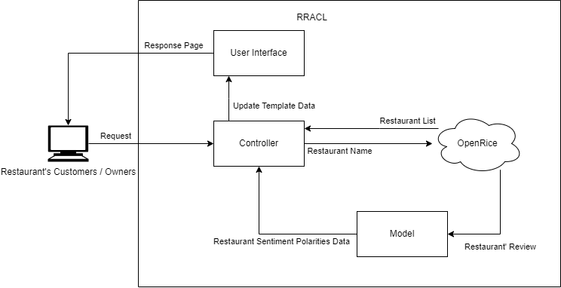
Methodology
Develop a Web application that deploy the ABSA Model
OpenRice
Controller the restaurant's information
Model
Predict the sentiment for OpenRice review data
User Interface
Display the result (polarities in positive, neutral and negative)
Display graph (Doughnut chart and Bar chart)

Slide 11
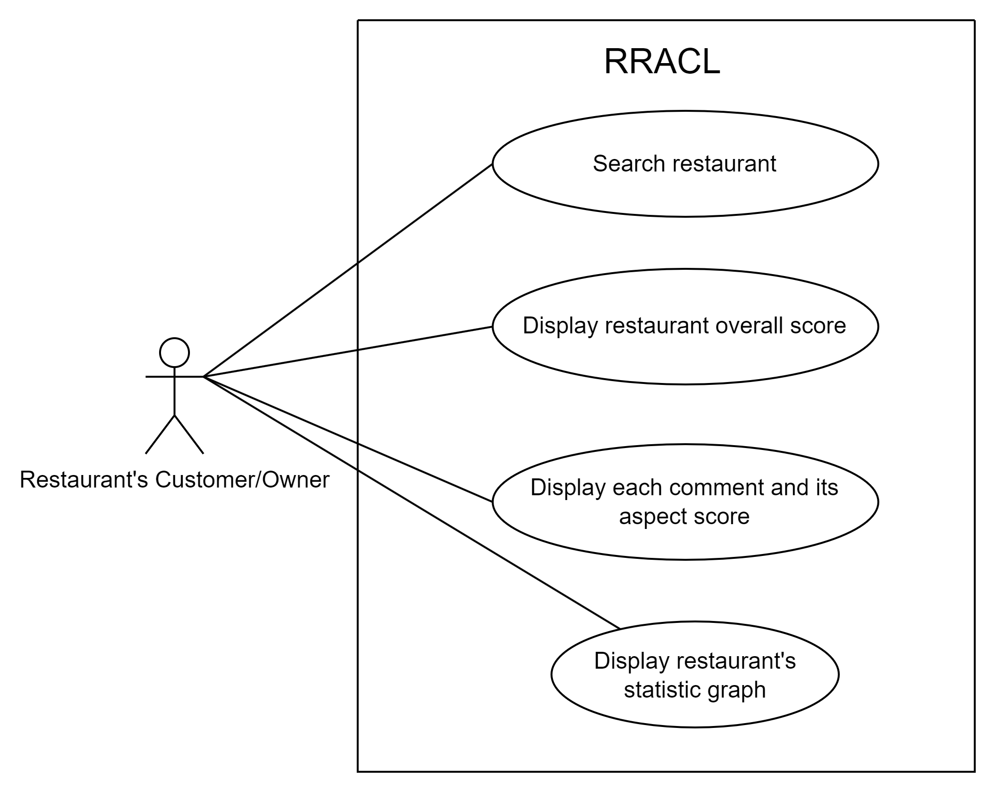
Methodology
Main Features in our application
Search restaurant
Shows restaurant overall score
Shows each comments and aspects score
Show statistic charts

Slide 12
Methodology – Dataset Collection (Cont.)
"AI Challenger Sentiment Analysis Training set 2018"
Use the Microsoft Bing Translator API translate the review to Cantonese
1,500 restaurant review data from OpenRice
Labelled the review by ours
500 dataset for model training
1000 dataset for model evaluating

Slide 13
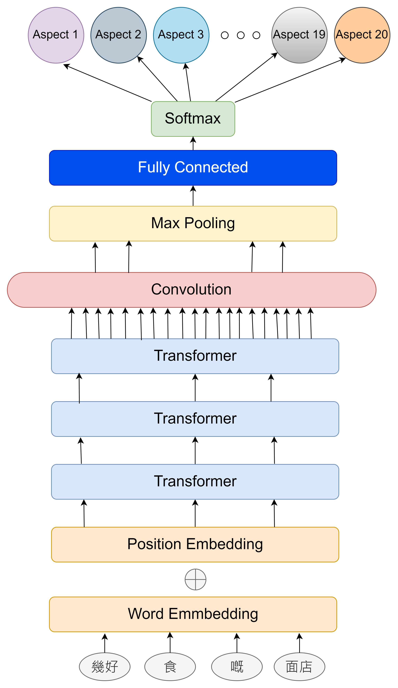
Result – Model Adaptation
AI Challenger model
Word segmentation – use the ‘jieba’ library with default Simplified Chinese dictionary
Stop word – use the Weibo Simplified Chinese stop word
Word Embedding – use the word2vec pretrain (by Weibo Simplified Chinese data)
Our adaptation
Word Segmentation – use the ‘jieba’ library with Cantonese dictionary
Stop word – Translate the Weibo stop word to Traditional Chinese and extend the stop word list by add the PyCantonese's stop word.
Word Embedding – use the Cantonese fastText pretrain (by ToastyNews data)
Notes:
For the model structure that we used in this project, it shown on the right picture.
For our adaptation with the model, we enhance the model performance to handle the Cantonese review,, we use jieba word segmentation library to import the Cantonese dictionary for segmentate Cantonese text, also we use the translated Weibo stop word and add the new Cantonese stop word to the list
Lastly, we change the word embedding from word2vec to the Cantonese fastText.

Slide 14
Result – Dataset List
Dataset | Short Terms | Division | Dataset size | Positive | Negative | Neutral | Not mentioned
45,000 AI Challenger Sentiment Analysis Training set 2018 (Original) | 45,000 AIC dataset | Train | 45,000 review data | 220,409 | 38,361 | 77,913 | 563,317
500 translated AI Challenger training set 2018 + Our 500 training dataset (Cantonese) or (Translate to Simplified Chinese) | 500 AIC + 500 OpenRice dataset | Train | 1000 review data | 127 | 7 | 5 | 892
45,000 translated AI Challenger training set 2018 + Our 500 training dataset | 45,000 AIC + 500 OpenRice dataset | Train | 45,500 review data | 222,413 | 38,522 | 78,066 | 570,999
OpenRice evaluation dataset (Cantonese) or (Translate to Simplified Chinese) | 1,000 OpenRice dataset | Test | 1,000 review data | 3,986 | 1,041 | 771 | 14,201
Notes:
In the dataset list, we collected 3 datasets for model training, and 1 for model evaluation.
And for the test dataset, this is the evaluation dataset that for evaluate the all the model performance in this project

Slide 15
Result – Experiment Setting
Models | Train dataset | Test dataset
Model 1: Simplified Chinese Model | 45,000 AIC dataset | OpenRice evaluation dataset (Simplified Chinese)
Model 2: Simplified Chinese Model | 500 AIC + 500 OpenRice dataset (Simplified Chinese) | OpenRice evaluation dataset (Simplified Chinese)
Model 3: Cantonese Model | 500 AIC + 500 OpenRice dataset (Cantonese) | OpenRice evaluation dataset (Cantonese)
Model 4: Cantonese Model | 45,000 AIC + 500 OpenRice dataset | OpenRice evaluation dataset (Cantonese)
Model 5: ChatGPT 3.5 turbo Model | N/A | OpenRice evaluation dataset (Cantonese)
Notes:
And for the model evaluation, we set up 5 models which is 2 simplified Chinese models, 2 Cantonese models, and 1 ChatGPT 3.5 turbo model,
And all these models are use the OpenRice test dataset to evaluate its performance, and this dataset using either Simplified Chinese or Cantonese is depends the model supported language,

Slide 16
Result – Experiment Setting
 | Model 1 Simplified Chinese model | Model 2 Simplified Chinese model | Model 3 Cantonese Model | Model 4 Fine-tune Cantonese Model | Model 5 ChatGPT 3.5 turbo
Embedding | Word2vec & position embedding | Word2vec & position embedding | FastText & position embedding | FastText & position embedding | /
Attention stacks (Transformer) | 3 | 3 | 3 | 3 | /
Dimensional size | 300 | 300 | 300 | 300 | /
Hidden dimensional size | 60 | 60 | 60 | 60 | /
Optimizer | Momentum 0.7 | Momentum 0.7 | Adam | Adam | /
Learning rate | 0.01 | 0.01 | 0.001 | 0.001 | /
Learning rate decay | 0.0 | 0.0 | 0.0 | 0.0 | /
Batch size | 32 | 32 | 32 | 32 | /
Regularization parameter | 0.001 | 0.001 | 0.001 | 0.001 | /
Dropout rate | 0.1 | 0.1 | 0.2 | 0.2 | /
Notes:
For this page, this is the hyper-parameters setting about the model 1 to model 5

Slide 17
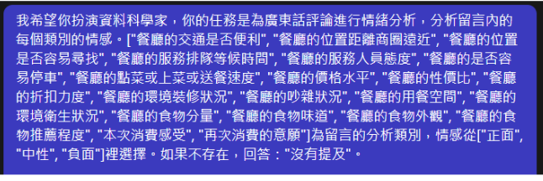
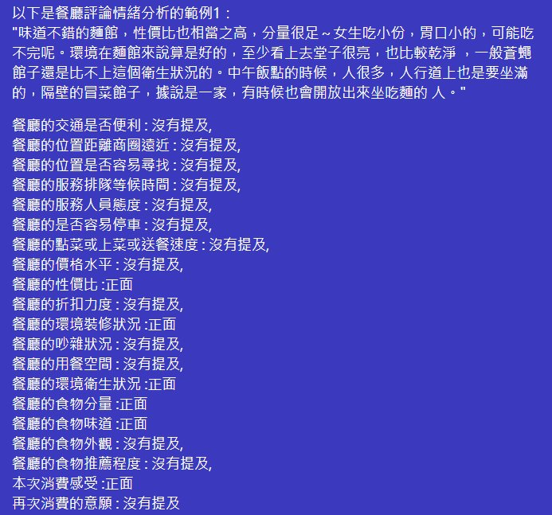
Result – Experiment Setting
We use the test dataset to evaluate the ChatGPT 3.5 turbo model's performance by analyzing the Cantonese restaurant review
Use ChatGPT prompt technique to predict the test dataset reviews to the analyzed specific aspects' polarity result
Use the correct test dataset and the analyzed results to calculate the F1 and Accuracy
ChatGPT Prompt
Notes:
For the ChatGPT 3.5 turbo, we use the review data from the OpenRice test dataset and predict its sentiment polarity by apply the ChatGPT prompt technique,
And after predicted all the test data, we use the correct dataset with predicted data to calculate its F1 and accuracy

Slide 18
Result – Experiment results and Performance Evaluation
Models | 1,000 OpenRice dataset (Cantonese or Simplified Chinese review data)
 | Accuracy | Marco-F1
Model 1: Simplified Chinese Model (train by 45,000 AIC dataset) | 77.74 (Simplified Chinese) | 40.47 (Simplified Chinese)
Model 2: Simplified Chinese Model (train by 500 AIC + 500 OpenRice dataset) | 77.3 (Simplified Chinese) | 31.96 (Simplified Chinese)
Model 3: Cantonese Model (train by 500 AIC + 500 OpenRice dataset) | 76.3 (Cantonese) | 30.66 (Cantonese)
Model 4: Fine-tune Cantonese Model (train by 45,000 AIC + 500 OpenRice dataset) | 78.66 (Cantonese) | 44.76 (Cantonese)
Model 5: ChatGPT 3.5 turbo Model | 36.16 (Cantonese) | 27.52 (Cantonese)
The model 4 has the highest performance in handling Cantonese restaurant review data
Therefore, we decides to use this model deploy to our application
Notes:
Here, this table is the result about our experiment, as you can see that the model 4 has the highest Accuracy and Marco-F1 score which are 78.66 and 44.76
As the result, we decides to deploy the Model 4 to our web application. I pass to my partner

Slide 19
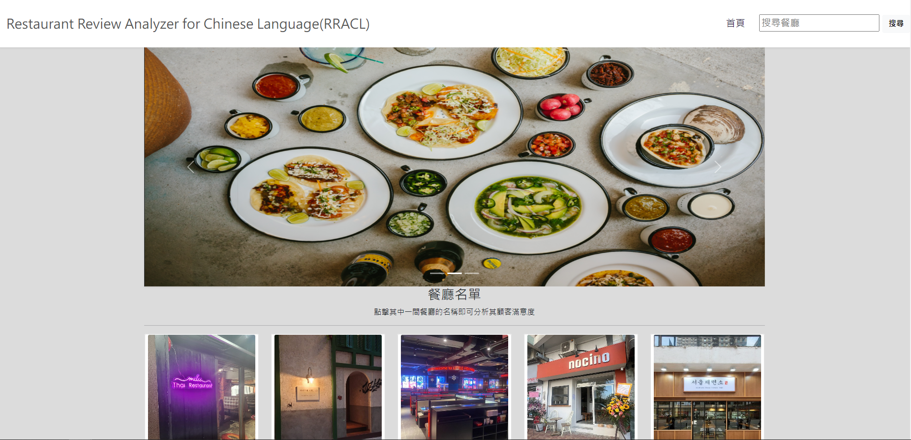
Result – User Interface

Slide 20
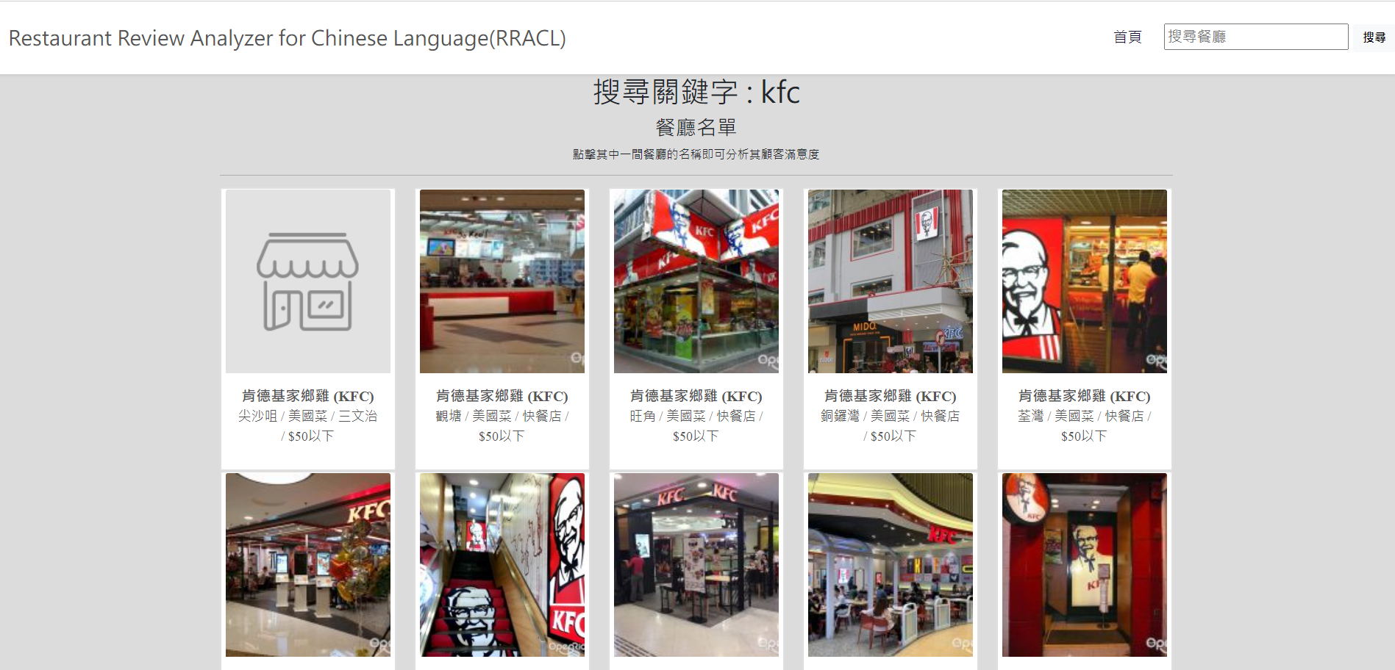
Result – User Interface (Cont.)

Slide 21
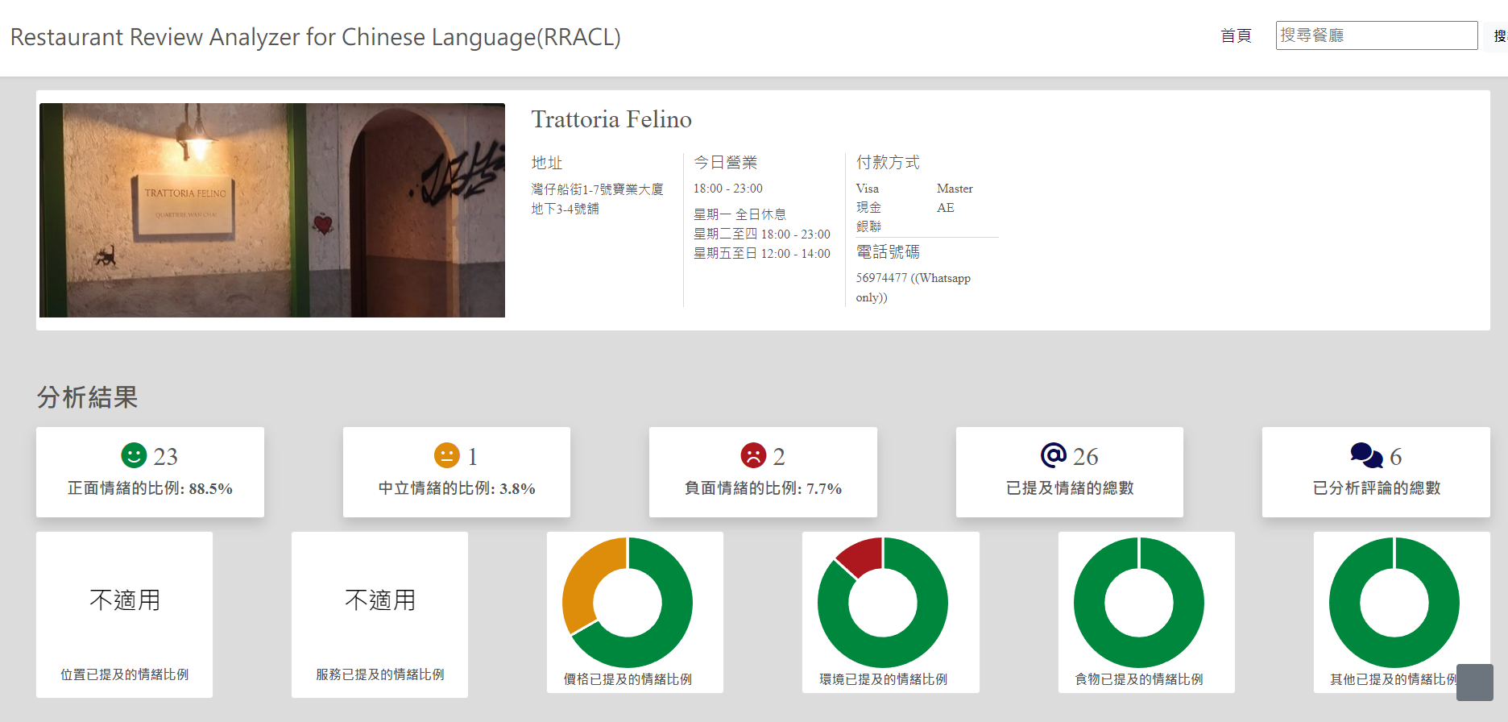
Result – User Interface (Cont.)

Slide 22
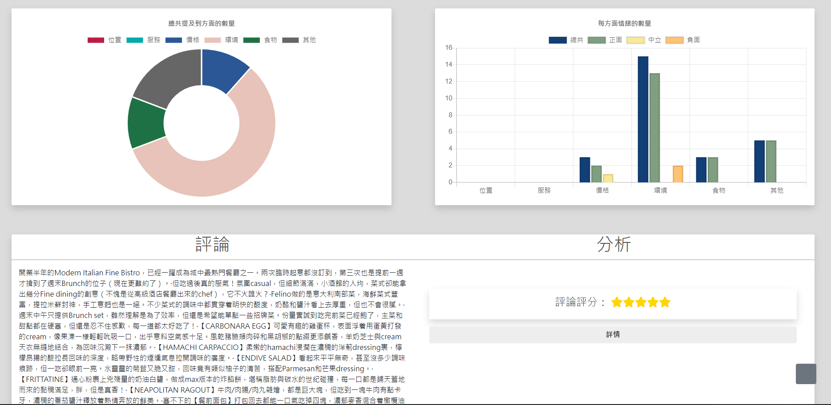
Result – User Interface (Cont.)

Slide 23
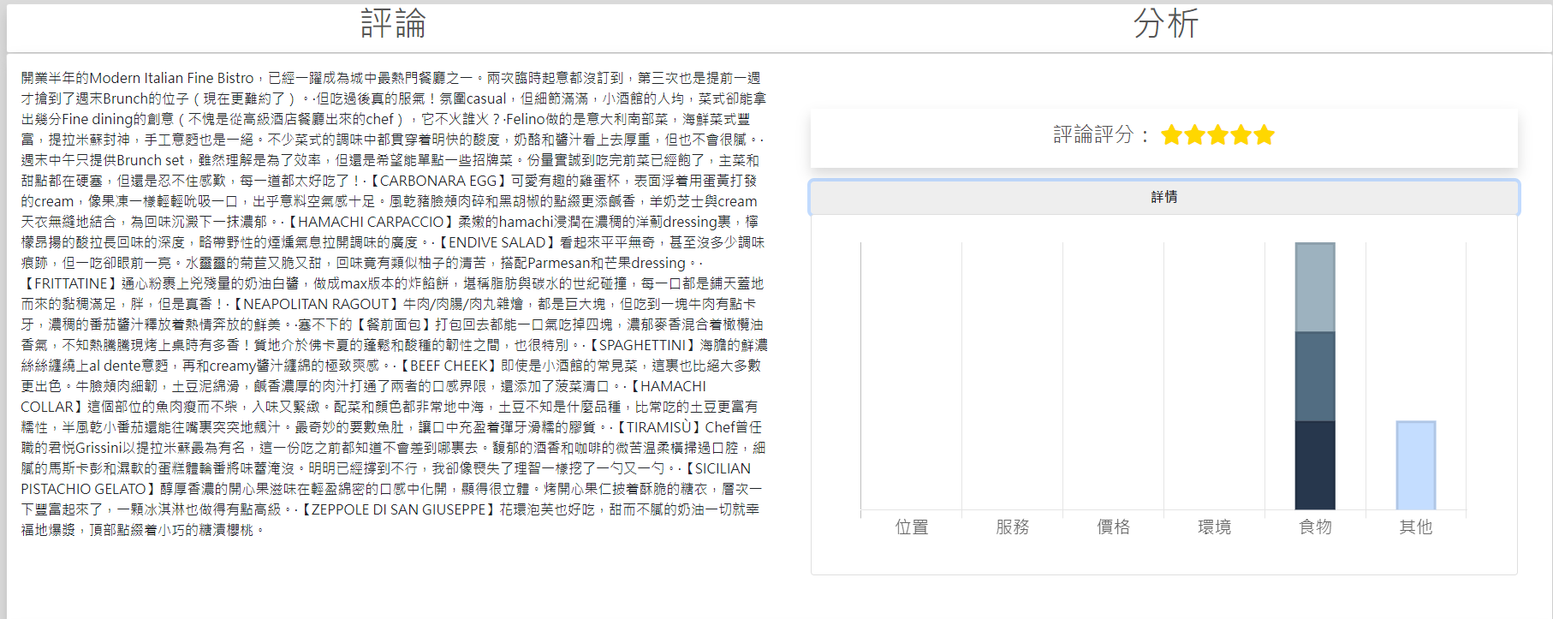
Result – User Interface (Cont.)

Slide 24
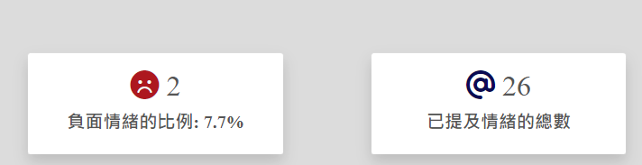
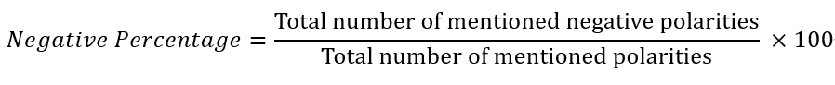
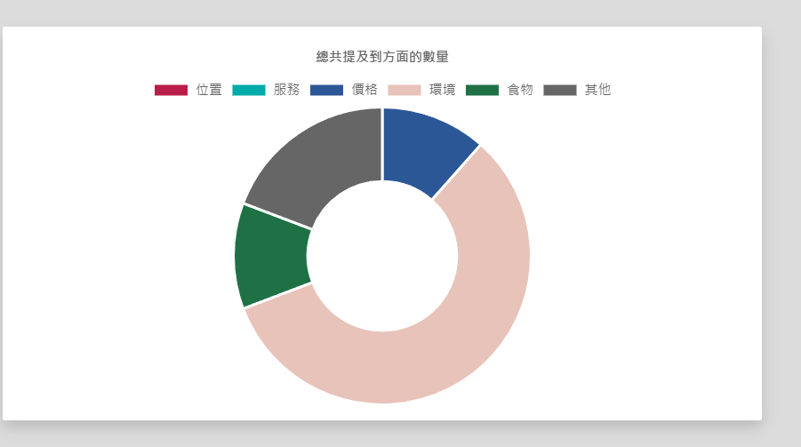
Result – User Interface (Cont.)
The negative percentage is calculated by the following formula:
The doughnut chart denotes that the total mentioned sentiments for each aspects

Slide 25
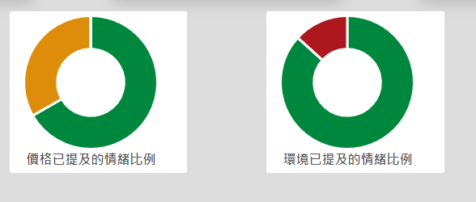
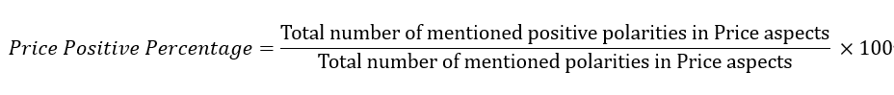
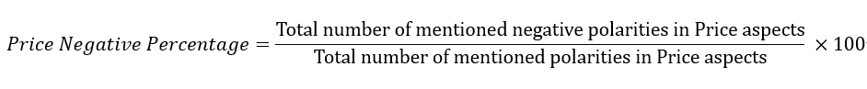
Result – User Interface (Cont.)
These doughnut charts denote that the each aspect of its polarity numbers
For example, the price has the sentiments of 7 neutral, 10 positive, 0 negative
These charts are also has the percentage calculation, here is the percentage formula for the price aspect:

Slide 26
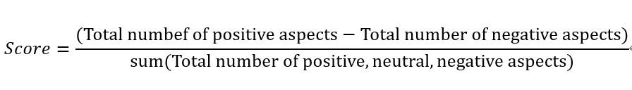
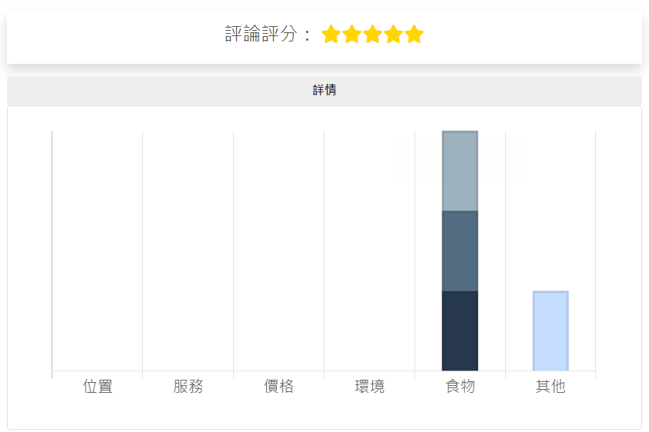
Result – User Interface (Cont.)
Star rating formula:
The stars shown depends on the score range
-1 is 0 star
-0.9 to –0.6 is 1 star
-0.5 to –0.2 is 2 star
-0.1 to 0.2 is 3 star
0.3 to 0.6 is 4 star
0.7 to 1 is 5 star

Slide 27
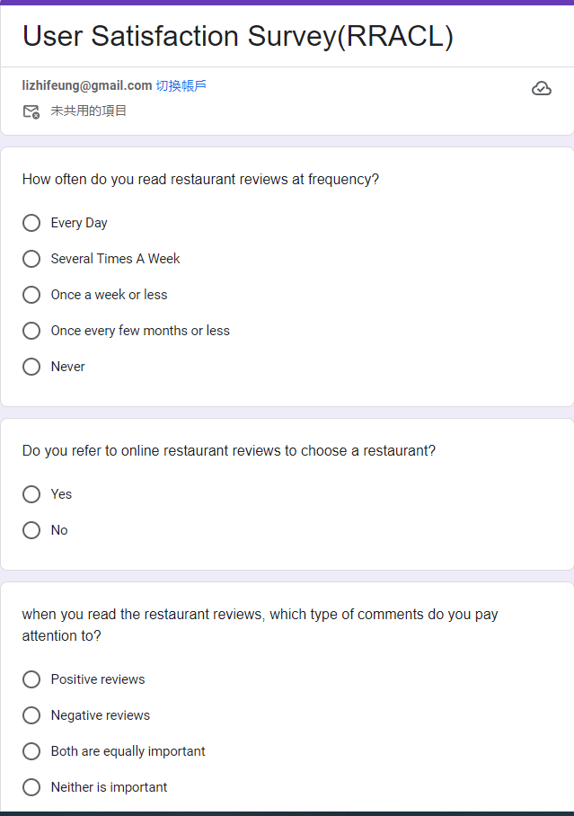
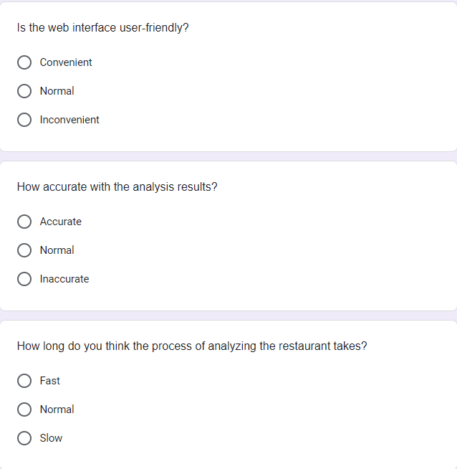
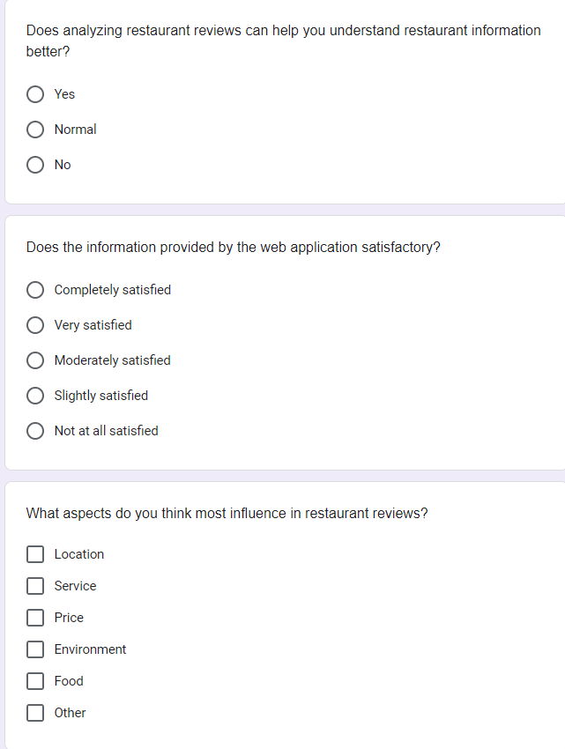
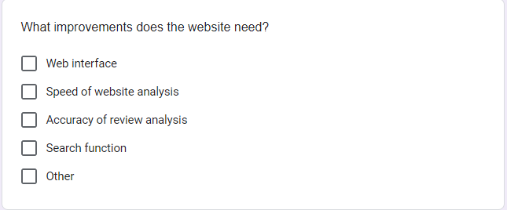
User satisfaction Survey

Slide 28
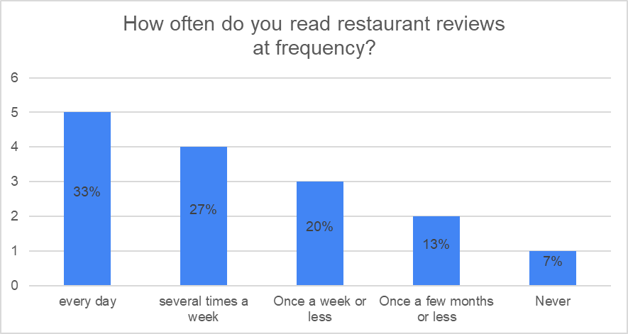
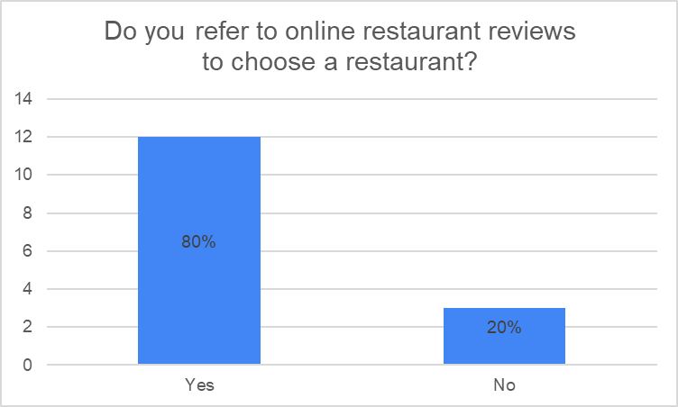
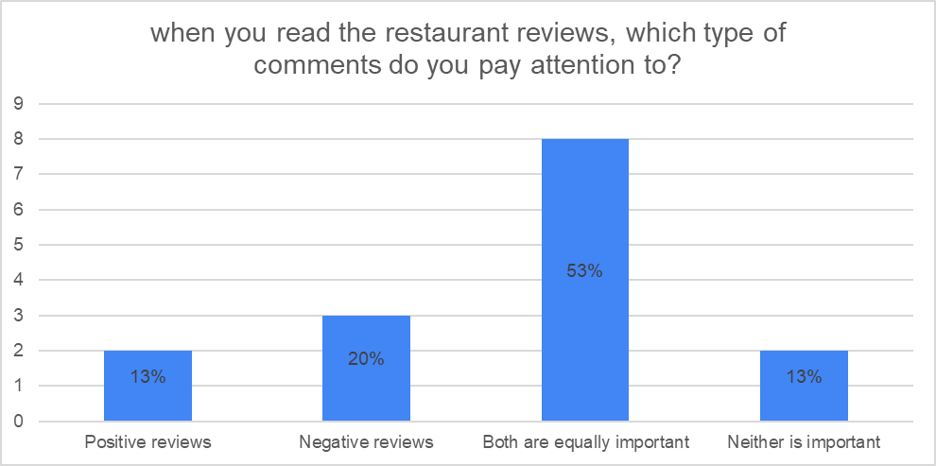
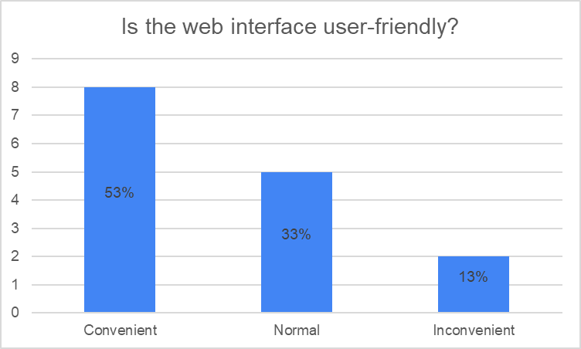
User Satisfaction Survey

Slide 29
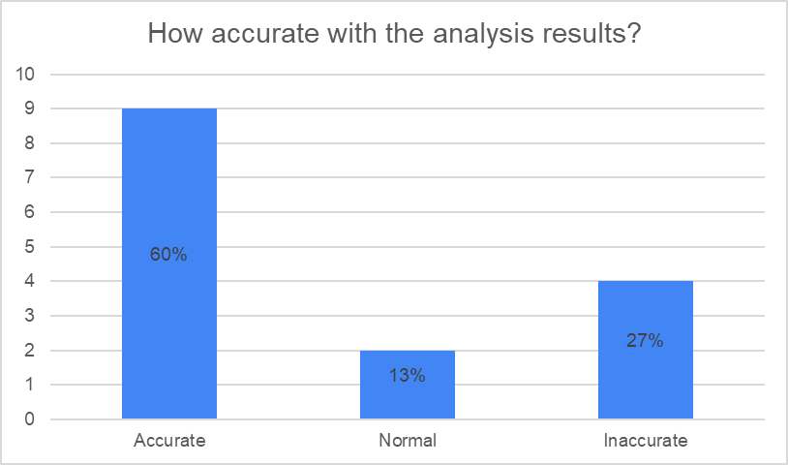
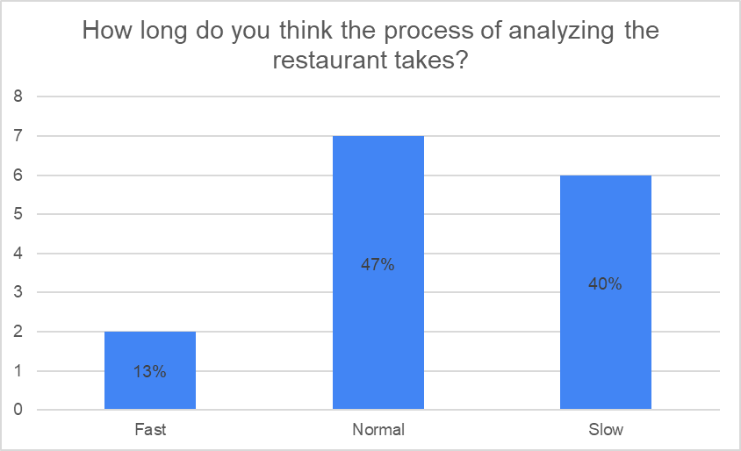
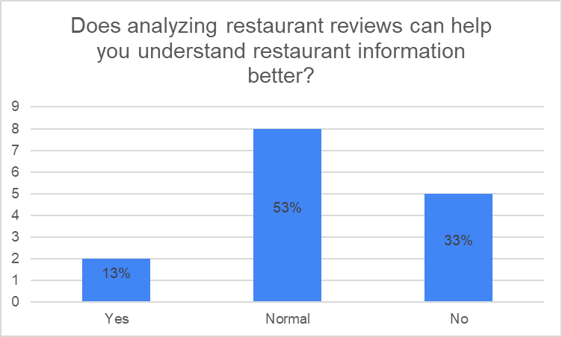
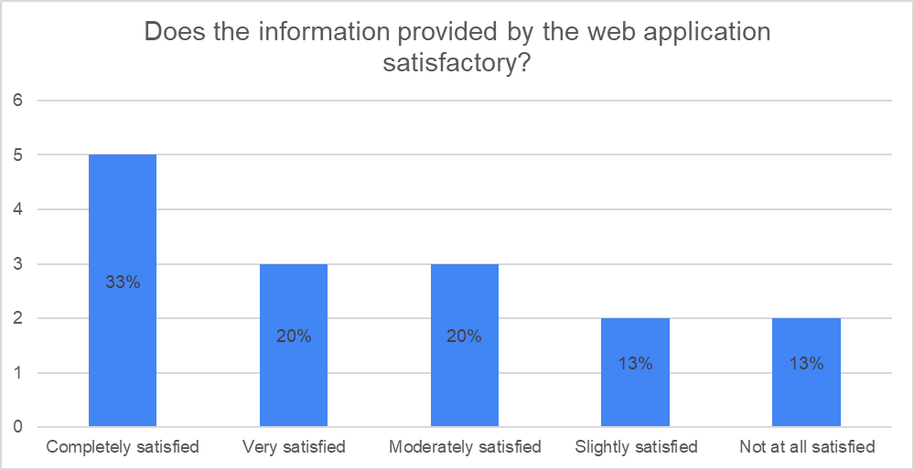
User Satisfaction Survey (Cont.)

Slide 30
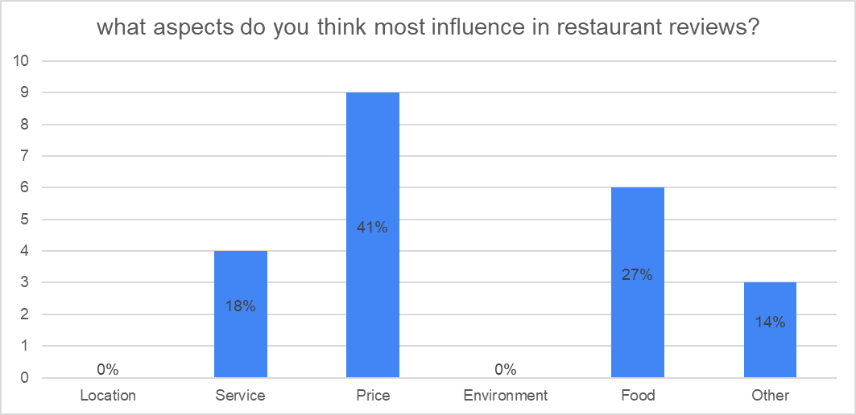
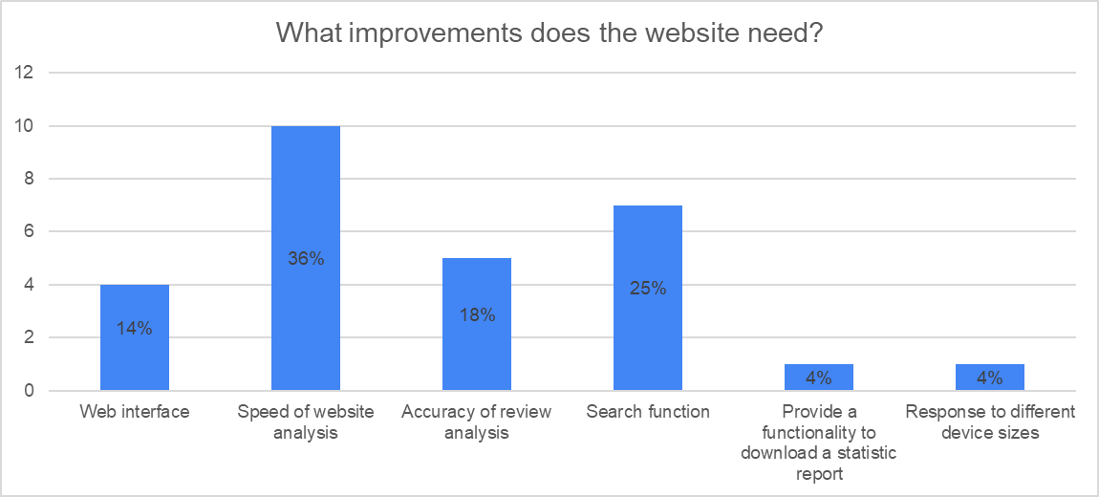
User Satisfaction Survey (Cont.)

Slide 31

Result – User Evaluation
15 test users tried our application
Refer to the online restaurant reviews (80%)
Rely on restaurant reviews
✅User-friendly (53%) , ✅accurate (60%) , ✅ Completely satisfied (33%)
Useful, Helpful
comprehensive restaurant information
Still need to improve
Speed of analysis (36%) , restaurant information (53%😶)

Slide 32

Conclusion
Aims
Save the time collecting opinions from restaurant review websites
✅ Achieve
Create web application
✅ Achieve
New Technology
Cantonese analysis restaurant review
Not common in Hong Kong
Future research
Improve analysis speed
Slow -> Normal -> Fast
Provide more information of restaurant
Food picture

Slide 33
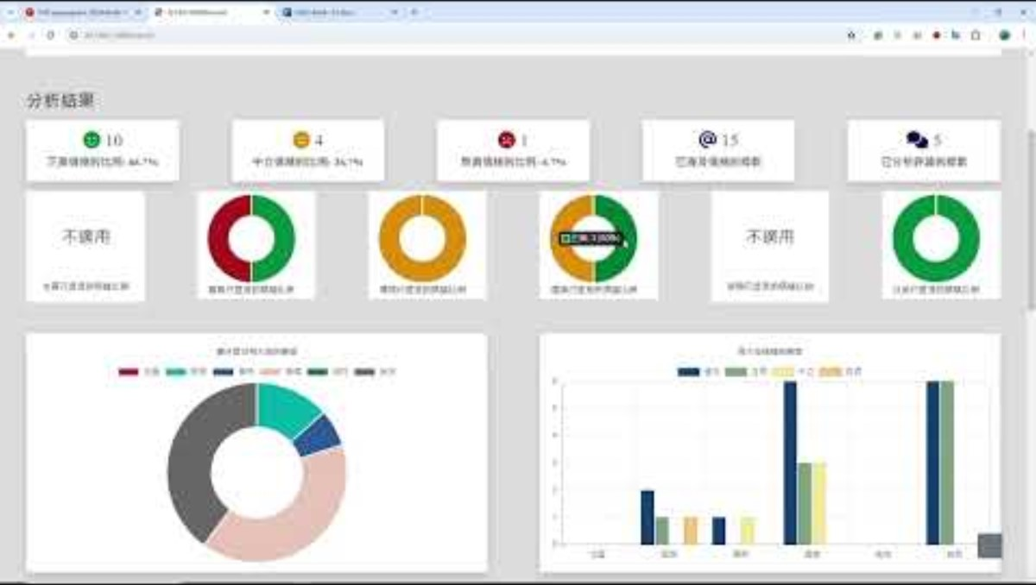
Demonstration

Slide 34
Q&A

Slide 35
Reference
aditya_taparia. (2023, June 8). Bidirectional LSTM in NLP. (GeeksforGeeks) Retrieved October 10, 2023, from GeeksforGeeks: https://www.geeksforgeeks.org/bidirectional-lstm-in-nlp/
Bootstrap 5 Get Started. (n.d.). (W3Schools) Retrieved November 3, 2023, from w3schools.com: https://getbootstrap.com/docs/5.0/getting-started/introduction/
Bruna, J., Zaremba, W., Szlam, A., & LeCun, Y. (2014). Spectral Networks and Locally Connected Networks on Graphs. arXiv:1312.6203. doi:https://doi.org/10.48550/arXiv.1312.6203
Bu, J., Ren, L., Zheng, S., Yang, Y., Wang, J., Zhang, F., & Wu, W. (2021). ASAP: A Chinese Review Dataset Towards Aspect Category Sentiment Analysis and Rating Prediction. Proceedings of the 2021 Conference of the North American Chapter of the Association for Computational Linguistics: Human Language Technologies, 2069–2079. doi:http://dx.doi.org/10.18653/v1/2021.naacl-main.167
BYVoid. (2023, October 15). OpenCC. Retrieved from GitHub: https://github.com/BYVoid/OpenCC
Chart.js. (2023, April 12). Retrieved from https://www.chartjs.org/docs/latest/
Czakon, J. (2023, September 5). F1 Score vs ROC AUC vs Accuracy vs PR AUC: Which Evaluation Metric Should You Choose? (Neptune Labs) Retrieved November 1, 2023, from neptune.ai: https://neptune.ai/blog/f1-score-accuracy-roc-auc-pr-auc

Slide 36
Reference
Defferrard, M., Bresson, X., & Vandergheynst, P. (2016). Convolutional Neural Networks on Graphs with Fast Localized Spectral Filtering. 30th Conference on Neural Information Processing Systems (NIPS 2016), 29, 3844-3852. Retrieved from https://proceedings.neurips.cc/paper_files/paper/2016/file/04df4d434d481c5bb723be1b6df1ee65-Paper.pdf
JohanyCheung. (2018, November 29). AI Challenger 细粒度用户评论情感分析. Retrieved from GitHub: https://github.com/JohanyCheung/fsauor/tree/master
Lee, J., Chen, L., Lam, C., Lau, C. M., & Tsui, T.-H. (2022). PyCantonese: Cantonese Linguistics and NLP in Python. Proceedings of the Thirteenth Language Resources and Evaluation Conference (pp. 6607–6611). European Language Resources Association.
Li, Z., Wei, Y., Zhang, Y., Zhang, X., & Li, X. (2019). Exploiting Coarse-to-Fine Task Transfer for Aspect-Level Sentiment Classification. Proceedings of the AAAI Conference on Artificial Intelligence, 33(01), 4253-4260. doi:https://doi.org/10.1609/aaai.v33i01.33014253
Liang, B., Su, H., Yin, R., Gui, L., Yang, M., Zhao, Q., . . . Xu, R. (2021). Beta Distribution Guided Aspect-aware Graph for Aspect Category Sentiment Analysis with Affective Knowledge. Proceedings of the 2021 Conference on Empirical Methods in Natural Language Processing, 208–218.
Lutkevich, B. (2023, September). What is Hugging Face? (TechTarget) Retrieved November 3, 2023, from Whatls.com: https://www.techtarget.com/whatis/definition/Hugging-Face

Slide 37
Reference
Metrics and scoring: quantifying the quality of predictions. (n.d.). Retrieved from scikit learn: https://scikit-learn.org/stable/modules/model_evaluation.html
NVIDIA CUDA in AI Deep Learning. (2022, October 6). (Exxact Corporation) Retrieved November 3, 2023, from EXXACT: https://www.exxactcorp.com/blog/Deep-Learning/NVIDIA-CUDA-in-AI-Deep-Learning
O'Shea, K., & Nash, R. (2015). An Introduction to Convolutional Neural Networks. ArXiv. /abs/1511.08458.
Raganato, A., Scherrer, Y., & Tiedemann, J. (2020). Fixed Encoder Self-Attention Patterns in. Findings of the Association for Computational Linguistics: EMNLP 2020 (pp. 556-568). Association for Computational Linguistics.
Ray, P. P. (2023). ChatGPT: A comprehensive review on background, applications, key challenges, bias, ethics, limitations and future scope. Internet of Things and Cyber-Physical Systems, 3, 121-154.
SarielWang. (2020, May 15). 機器學習模型評估指標-confusion matrix, precision, recall, and ,F1-score. Retrieved November 1, 2023, from Medium: https://medium.com/@s716419/%E6%A9%9F%E5%99%A8%E5%AD%B8%E7%BF%92%E6%A8%A1%E5%9E%8B%E8%A9%95%E4%BC%B0%E6%8C%87%E6%A8%99-confusion-matrix-precision-and-recall-e9d64ff14d81
Staff, A. (2023, May 18). How To Improve Your Restaurant’s Table Turnover: The Ultimate Guide. (Agilence, Inc) Retrieved October 3, 2023, from Agilence: https://blog.agilenceinc.com/table-turnover
Su, J. (2023, August 1). Master the Perfect ChatGPT Prompt Formula (in just 8 minutes)! Retrieved from YouTube: https://www.youtube.com/watch?v=jC4v5AS4RIM
Text Translation. (n.d.). (Microsoft) Retrieved from Microsoft: https://www.microsoft.com/en-us/translator/business/translator-api/

Slide 38
Reference
ToastyNews, & lso. (2020, July). hong-kong-fastText. Retrieved from github: https://github.com/toastynews/hong-kong-fastText
toby_hk2001. (2023, April 16). Tsui Hang Village (Mira Place 1) - Review. (OpenRice) Retrieved October 10, 2023, from https://www.openrice.com/en/hongkong/review/%E5%B7%AE-e4787429
Trisna, K. W., & Jie, H. J. (2022). Deep Learning Approach for Aspect-Based Sentiment Classification: A Comparative Review. Applied Artificial Intelligence, 36(1). doi:10.1080/08839514.2021.2014186
Use Font Awesome on the Web. (n.d.). Retrieved from Font Awesome Docs: https://docs.fontawesome.com/web/
wchan757. (2019, November 30). Cantonese Word Segmentation. Retrieved from github: https://github.com/wchan757/Cantonese_Word_Segmentation
What is Beautiful Soup? (n.d.). (Educative, Inc) Retrieved November 3, 2023, from educative: https://www.educative.io/answers/what-is-beautiful-soup

Slide 39
Reference
What Is Cross-Entropy Loss Function? (2023, June 15). (The 365 Team) Retrieved from 365 DataScience: https://365datascience.com/tutorials/machine-learning-tutorials/cross-entropy-loss/#1
What is Data Cleansing? (n.d.). (Amazon Web Services, Inc) Retrieved November 1, 2023, from aws: https://aws.amazon.com/what-is/data-cleansing/
What is Flask Python. (n.d.). (pythonbasics.org) Retrieved November 3, 2023, from Python Tutorial: https://pythonbasics.org/what-is-flask-python/
What is PyTorch? (n.d.). (NVIDIA Corporation) Retrieved November 3, 2023, from NVIDIA: https://www.nvidia.com/en-us/glossary/data-science/pytorch/
Yegulalp, S. (2024, January 5). What is TensorFlow? The machine learning library explained. Retrieved from InfoWorld: https://www.infoworld.com/article/3278008/what-is-tensorflow-the-machine-learning-library-explained.html
Zhang, Z., Zhou, Z., & Wang, Y. (2022). SSEGCN: Syntactic and Semantic Enhanced Graph Convolutional Network for Aspect-based Sentiment Analysis. Proceedings of the 2022 Conference of the North American Chapter of the Association for Computational Linguistics: Human Language Technologies, 4916–4925. doi:http://dx.doi.org/10.18653/v1/2022.naacl-main.362

